Slide 1
Make your future extraordinary Join some of the best students from around the globe at one of the world’s top universities
Information for Postgraduate Students Dalinda Pérez-Alvarez, IRT

Slide 2
Study in Scotland
Steeped in history but modern and progressive
Picturesque countryside, busy lively cities
Population of 5.4million, one third of UK’s land mass
Excellent transport links, well connected to major UK cities, Europe and beyond
Own parliament and education system
Hospitable and welcoming
Notes:
Welcoming, safe, and diverse country, with a vibrant cultural scene, positive social policies, and many green spaces.
Here in Scotland, we like to think of ourselves as belonging to a distinctive culture and to a country of contrasts. We’re a country steeped in history, but we’re also a modern, progressive and welcoming too.
We’re a country of geographical contrasts: with fantastic scenery, munros and lochs to explore – (for those of you not fluent in Scottish words - munros are the mountains in Scotland that are over 3000 feet high and lochs are the Scottish word for lake. You may have heard of the Loch Ness Monster)
In addition to our picturesque countryside we also have busy, lively cities like Edinburgh and Glasgow.
We have a population of around 5 ½ million, which is 8.5% of the UK population. To put this into perspective – London’s population is over 8 million.
And although we have a total population less than the city of London, we have about a third of the UK’s land mass. This means we’re not too densely packed in and you have lots of space to explore.
Scotland is well connected to the rest of the UK, with good links to major cities like Newcastle, Manchester, Leeds, and London, not to mention Glasgow, Aberdeen and Dundee. But it is also connected to the rest of Europe and beyond thanks to our international airports (one of which is located quite conveniently here in Edinburgh).
Scotland has its own Parliament and a very distinct education system, which means that degrees differ in some important ways to other UK and European universities.
Lastly, Scotland is famously a very hospitable and welcoming country, too, so you’ll feel really at home here.

Slide 3
World-class city
Scotland’s capital, an irresistible blend of history, natural beauty and modern city life
Safe and prosperous
Abundance of parks and green spaces
World famous cultural hub
Friendly and diverse multicultural community
Large enough to offer something for everyone, small enough to feel like home
Notes:
The city of Edinburgh is home to a friendly and diverse population of around 525,000 people. Of this, we have approximately100,000 students attending classes in one of the 4 universities that are located around the city of Edinburgh. That means students are an important part of the social, cultural and economic life of the city, and there’s lots of keep students entertained during their time at university.
Edinburgh is an inspiring capital city, with a thriving economy, and is a world famous cultural hub. It is widely considered one the world’s most desirable places to live and particularly an excellent city in which to live and study as a student.
Edinburgh is the second best student city in the UK and the 7thin Europe according to the QS Best Student Cities 2019.
We’re home to more Financial Times Stock Exchange 100 companies than any other city outside London and we’re the second biggest financial hub in the UK. We typically have jobs available in arts and publishing, hospitality and tourism, government and third sector, banking and financial services, and science, technology and data services.
Beyond that, we’re a popular tourist destination and are known as the “festival city” –the city hosts over 30 festivals annually, including the International Festival and Edinburgh Festival Fringe every August, which is the largest performing arts festival in the world.
If you’ve ever visited, I hope you’ll agree with me when I say that we’re a historic, architecturally stunning and cultured city. We are home to a UNESCO World Heritage Site (Old and New Towns combined) and we are the world’s first UNESCO City of Literature.
Edinburgh is a very safe city and is also the UK’s 2ndgreenest city, too, thanks to our lovely, extensive greenspace and the city’s commitment to sustainability. We have more than 230 sqm of green space per resident,
Edinburgh is big enough to offer something for everyone, small enough to feel truly at home. It’s very compact and walkable, but there’s great public transport connections and a bike hire scheme if you need it to get around.

Slide 4
World-leading university
22nd in the world QS World Rankings 2024
Experience the very best in teaching, research and innovation in the Arts, Humanities, Social Sciences, Medicine, Veterinary Medicine, Science and Engineering
We equip you with the skills, insights and perspectives to enhance your employability and build a successful future
Notes:
The University of Edinburgh is an historic and prestigious institution, one of six ancient universities in the UK founded in 1583. Renowned as a leading research institution, the quality and breadth of our research or research power makes us one of the UKs most powerful and impactful research bodies. The latest REF 2021 results reveal nearly 90 per cent of the University’s research activity is world leading and internationally recognized. REF is the system for assessing the quality of research in UK HEIs.

Slide 5
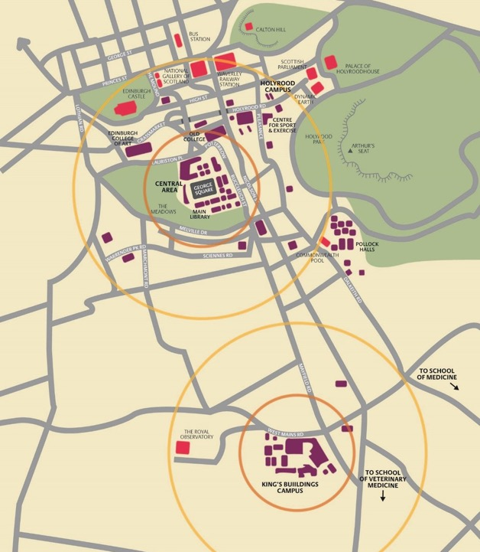
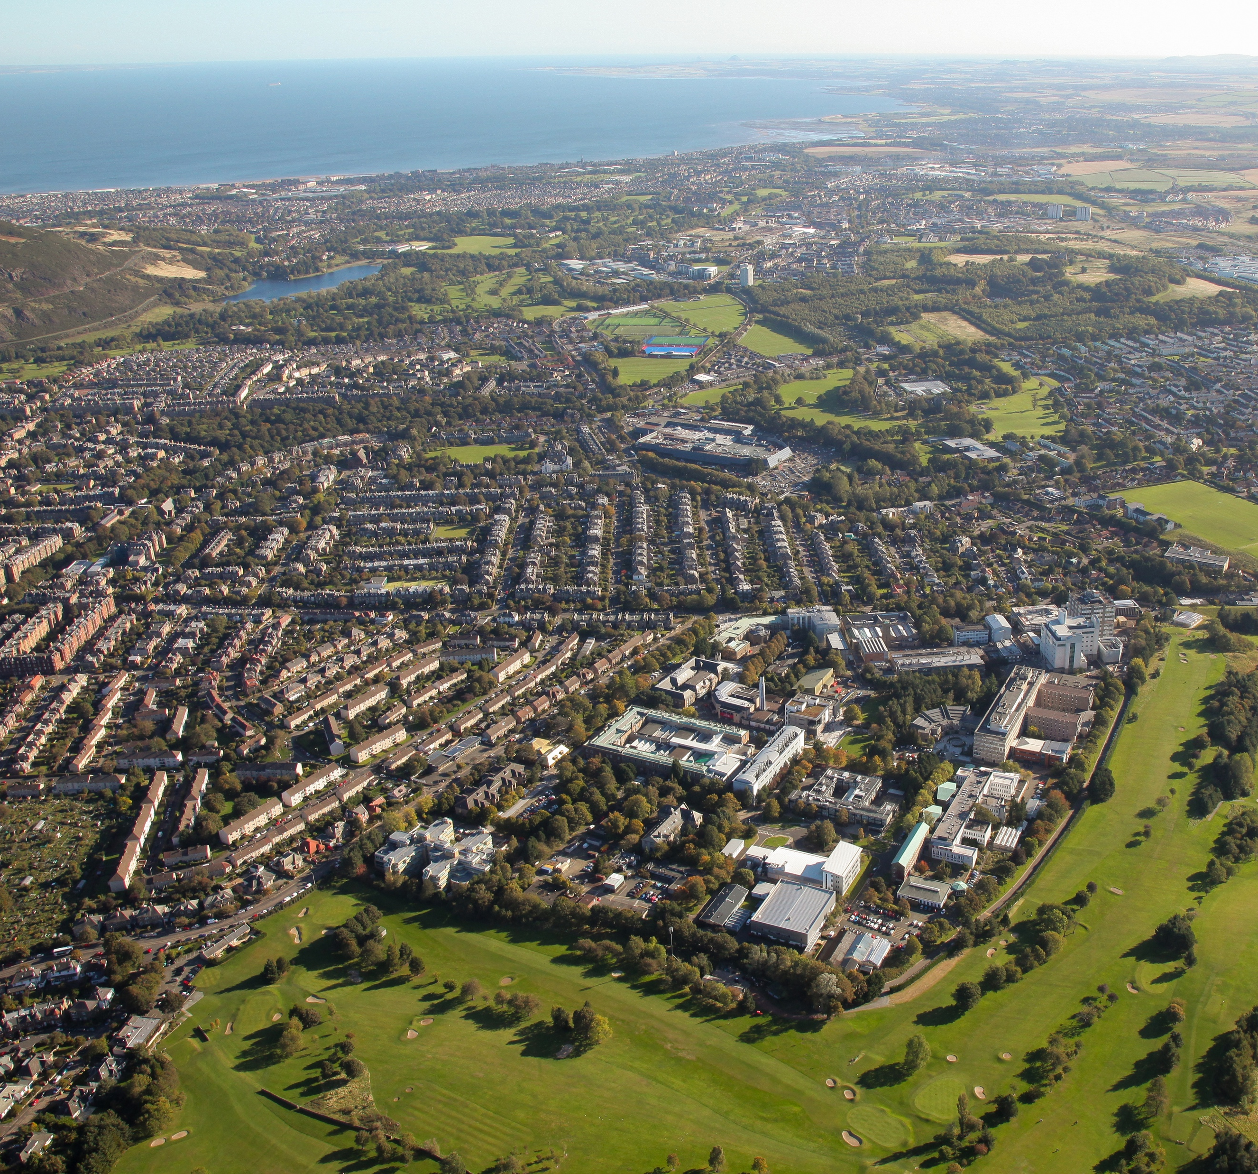
The University in the City
KEY
= University buildings
= City landmarks
= Park spaces
5 minute walk
15 minute walk
Take a Virtual visit of the campus

Slide 6
City centre campus
Not a campus based institution: the entire city of Edinburgh is our campus
Four main locations: Central Area, King’s Buildings, Little France, Easter Bush
Compact and walkable city with reliable public transport
Walk, cycle or bus between locations
Safe city and 24 hour campus security
Notes:
One of the top universities targeted for recruitment, 96.5% graduate employability rate
Edinburgh helps you develop the subject knowledge, skills and experiences, graduate attributes that you need to succeed and have a successful career.

Slide 7
Learn from the best
Unlocking the secrets of the universe, cloning sheep, building robots, devising technology used in today’s smartphones
Our ground-breaking research directly informs the teaching you receive
Learn about the very latest developments in your subject
Our degrees respond to global challenges and equip you with the tools to tackle these problems yourselves
Notes:
As a student at Edinburgh you will learn from world-leading researchers.
Our global reputation for teaching and research helps us to attract the international research community’s sharpest minds, which in turn means world-class teaching for our students.
Our world-class academics are leaders in their fields, conducting groundbreaking research that directly informs the teaching you receive.
As a student at Edinburgh you will work alongside these academics and learn about the very latest developments in your subject.
Our excellent research informs the teaching you receive, so you’ll be learning from experts pushing the boundaries of their discipline.
This is exciting, because it means our degree programmes are responding to global challenges, equipping you with the tools to tackle these problems yourselves.

Slide 8
Global community
Edinburgh attracts the best students from all over the world
Over 49,000 students from more than 160 countries worldwide
Discover different ideas and experiences, learn more about the world
Over 15,000 staff with one academic staff member to every six students
The city is home to approx. 100,000 students
Notes:
Figures based on 2021/22 student data
https://www.ed.ac.uk/governance-strategic-planning/facts-and-figures/university-factsheet

Slide 9
Imagine what you could do
3 Colleges reflect our main areas of teaching and research; 21 Schools group together our subject experts, support staff, students and facilities
380+ undergraduate programmes across 58 subject areas
Internationally recognised qualifications prized by employers
Two 11-week semesters (Sep–Dec & Jan–May)
Summer – good time for internships, projects, travel

Slide 10
College of Arts, Humanities & Social Sciences (CAHSS)
Average first year UG intake: 3,300
12 Schools
Business
Divinity
Economics
Edinburgh College of Art
Education
Health in Social Science
History, Classics and Archaeology
Law
Literatures, Languages and Cultures
Philosophy, Psychology & Language Sciences
Social and Political Science
Centre for Open Learning
College of Medicine & Veterinary Medicine (CMVM)
Average first year intake UG: 450
2 Schools
Edinburgh Medical School: 3 Deaneries
Biomedical Sciences
Clinical Sciences
Molecular, Genetic and Population Health Sciences
Royal (Dick) School of Veterinary Studies
College of Science & Engineering (CSE)
Average first year UG intake: 1,700
7 Schools
Biological Sciences
Chemistry
Engineering
Geosciences
Informatics
Mathematics
Physics & Astronomy
Search the Degree Finder for more information on our degree programmes

Slide 11
Welcome to learning at EFI
Dr Kate Orton-Johnson
Director of Education, Edinburgh Futures Institute
#ChallengeCreateChange

Slide 12
inter- disciplinary
Bringing arts, humanities and social sciences together with sciences, engineering and medicine to address complex global issues.
Working on pressing social issues that require new ways of thinking. Mindful of the role of universities in confronting uncomfortable questions.
critical
participatory and porous
Inviting diverse groupings to bring their ways of working and thinking together. EFI extends this invitation to industry, the public and government.
Embracing the non-traditional, the untried and the unexpected. EFI defines challenges and co-creates responses to build better futures.
future-facing
Jeff Wall, 2018
#ChallengeCreateChange

Slide 13
What’s different about Education in EFI?
interdisciplinary programmes taught by leading academics from different Schools and disciplines
equipping you with the critical, data and creative skills needed to navigate a rapidly-changing world
study online, on-campus or a combination of both
apply leading-edge knowledge to live projects you care about
Connect with partners in the community, industry and government
#ChallengeCreateChange

Slide 14
‘Fusion’ teaching: breaking down the online/on-campus distinction
inclusive: full time, part time, intermittent and lifelong study
flexible: you can choose to study online or on-campus at the level of each individual course
community-focused: bringing students from across the world together as a single cohort
accessible: most courses are taught via two-day intensives with pre- and post-intensive activity
connected: employers work with us on the design and teaching of our programmes and help support projects

Slide 15
What can I study in EFI?
Pioneer MScs
Finance, Technology and Policy
Leading Major Programmes
2023 ‘Sustainability/ Justice’ MScs
AI and Data Ethics
Planetary Health
Sustainable Lands and Cities
Circular Economy
Launching this year
2024 MSc
Sustainable Infrastructure
Digital Cultural Heritage
International Child Protection
2022 ‘Futures’ MScs
Creative Industries
Education Futures
Narrative Futures: art, data, society
Data, Inequality and Society
Future Governance
Service Management and Design
2023 MA(Hons)
Interdisciplinary Futures

Slide 16
Our programme structure
Shared core (40 credits)
Project (40 credits)
Integration (20 credits)
Programme core (20 or 30 credits)
Electives (60 credits)
#ChallengeCreateChange

Slide 17
Teaching models: changing the shape of your learning
Semester-Long Model
'Shared core' courses are delivered in 2-hour sessions every two weeks. These are scheduled for Wednesday mornings.
5 week intensive model
2 weeks pre intensive activities ( largely asynchronous)
2 day intensive teaching block
2 weeks post intensive activities (largely asynchronous)
#ChallengeCreateChange

Slide 18
Circular Economy
Toni Freitas, School of Geosciences

Slide 19
What is ‘Circular Economy’?
Circular economy means moving away from the world’s predominantly wasteful economic model and redefining how we use resources to design out waste and pollution, keeping products and materials in use for as long as possible. It encourages a rethink of consumerism as a society – locally and globally.
Why study MSc Circular Economy?
a rapidly evolving field: this programme is designed to be agile and responsive the ongoing environmental crisis
an interdisciplinary and challenge-led programme
gain circular economy advanced knowledge to support communities, businesses and policy makers for a sustainable future
explore and nurture ideas for disrupting the ‘take, make, dispose’ status quo
governments and business leaders are looking for employees that are committed to a more regenerative, lower carbon economy
develop your career in related fields including policymaking, waste management, product design, manufacturing, consultancy (business and financial), construction and engineering, supply chain management, textiles, plastics, and agriculture and public sector

Slide 20
What you will do and learn
The EFI shared core courses teach you basic data skills and interdisciplinary thinking.
The Circular Economy core courses focus on core concepts in circular economy (Geosciences), design for the circular economy (Design School) and business perspectives on the shift to circular (Geosciences)
Elective courses
Likely to cover areas including: Circular Economy in the Built Environment (Engineering)
Waste Law in Circular Economy (Law School)
Introduction to Life Cycle Assessment (Business School)
Sustainability on Both Sides of the Lens (Edinburgh College of Art)
Social Justice in the Circular Economy (Geosciences)
Circular Economy in Materials (Chemistry)
plus electives from other EFI programmes Project
Have the chance to shape your learning journey to meet your own circular economy interests and objectives, through your final project.

Slide 21
AI and Data Ethics
Professor Shannon Vallor
Centre for Technomoral Futures

Slide 22
What we offer
A new, interdisciplinary degree within the Edinburgh Futures Institute launched in September 2023
Designed with UoE’s world-leading expertise in this area, drawing on philosophy, law, informatics, and science and technology innovation studies (STIS)
Meets the urgent demand for interdisciplinary skills and knowledge in the ethical design, use and governance of artificial intelligence and other data-intensive technologies.

Slide 23
What you’ll learn
Key challenges for the ethical design and use of AI and data
How to map ethical values, principles, and practices onto AI & Data, and how they relate to regulation, policy, and design
How to identify and evaluate practical interventions to align AI and data-intensive tools with ethical norms.
How to translate and clearly communicate ethical concepts and framings for diverse audiences and across multiple domains of data/AI application.
How to lead and work collaboratively with others to produce clear, accessible, and actionable guidance and tools for ethical design and governance of AI & data technologies

Slide 24
Who needs the skills you’ll get
Industry: Policy, compliance, trust and safety, UX, privacy and data governance, risk management, DEI, responsible innovation and product review/management teams
Public Sector: Auditing, digital transformation and strategy groups, policy, regulatory and advisory bodies
Third Sector/Civil Society: Citizen advocacy groups, philanthropic foundations, think tanks, watchdog orgs, human rights organisations, non-profit public services and research organisations

Slide 25
What you will do and learn
The EFI shared core courses teach you basic data skills and interdisciplinary thinking.
The AI and Data ethics core courses focus on DATA & AI ETHICS, LAW & GOVERNANCE DATA ETHICS AS A PRACTICE)
Elective courses
Likely to cover areas including: Algorithmic Bias, Fairness and Justice
Translational Data and AI Ethics
Ethics of Robotics and Autonomous Systems
Democracy, Rights & the Rule of Law in the Data-Driven Society
__________________________________
Digital Influence
Coloniality of Data
Work Futures
Education, Personalisation and Surveillance
Narratives of Digital Capitalism
PROJECT
- ethical design of ‘smart’ and sustainable cities
- ethical use of AI to optimise allocation of health care resources
- ethical use of data to identify bias/discrimination in the judicial system
- ethical use of analytics to identify at-risk children in the social care system
- ethical use of biometric data to predict and manage disease outbreaks
- ethical design of robots for use to support elder care
- ethical design of ‘open data’ tools to increase government transparency
- ethical design of AI tools for content moderation/disinformation detection
Notes:
DATA & AI ETHICS, LAW & GOVERNANCE Examines how ethical norms work alongside law, policy and other modes of AI and data governance to steer the production and use of these technologies to align with justice and the reduction of harm, as well as the realisation of benefits for individuals and society.
DATA ETHICS AS A PRACTICE Exposure to concrete methods, skills and techniques for putting AI and data ethics into practice, individually and in teams. Through case studies, you’ll learn about using tools like model cards and datasheets, practice building ethical risk and threat models, and co-develop ethical design briefs and/or ethical research or product reviews.

Slide 26
You and EFI
Learning beyond the “classroom”
EFI events programme
Subject area events and seminars
University wide events
Find your community
Make your community
#ChallengeCreateChange

Slide 27
Luksic Scholarship at Edinburgh Futures Institute
The Luksic Scholarship at EFI offers 3 scholarships for On-Campus, Full-Time study of one of the following programmes: MSc AI and Data Ethics or the MSc Circular Economy
The award is for full-time, on-campus study only. To be eligible for this scholarship, an applicant must be a Chilean citizen domiciled in Chile (and not holding dual citizenship of a nation that would allow them to pay local fees). The scholarships will be awarded based on academic merit, however, we will also consider whether the candidate can demonstrate some or all of the following:
• interest in social change in Chile
• evidence of work experience either in the public sector or in a role with strong social impact
• is the first in their family to attend University
• is from a region outside of Santiago
Each scholarship will cover full international tuition, a stipend for living expenses (paid monthly), and a one-time travel/arrival stipend.
#ChallengeCreateChange

Slide 28
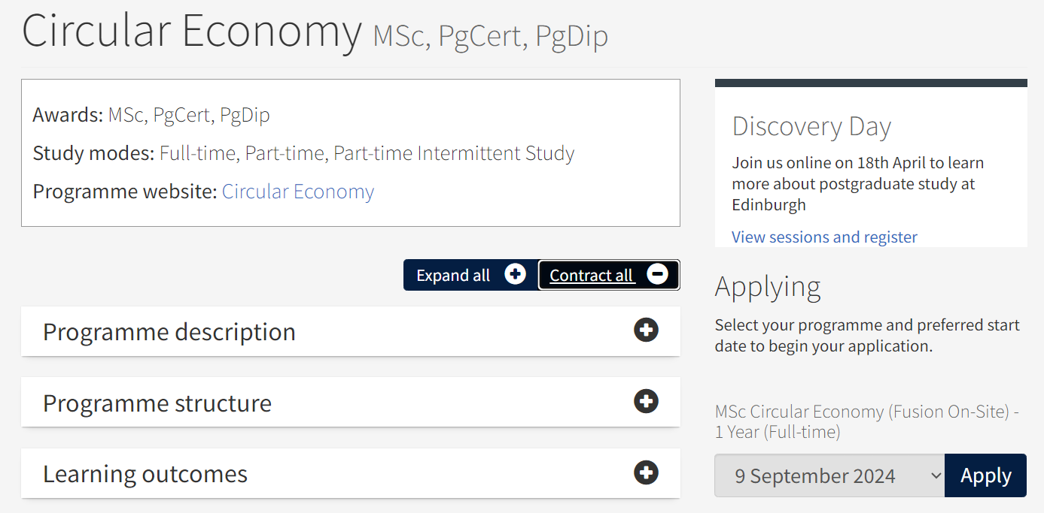
Luksic Scholarship at Edinburgh Futures Institute
How to Apply:
First step: Apply for the MSc of interest by
Following applicable link below.
Click: "Apply to study on-campus"
This will open a new window
Select start date from drop down,
click Apply.
https://efi.ed.ac.uk/programmes/circular-economy/
https://efi.ed.ac.uk/programmes/data-and-artificial-intelligence-ethics/
#ChallengeCreateChange

Slide 29
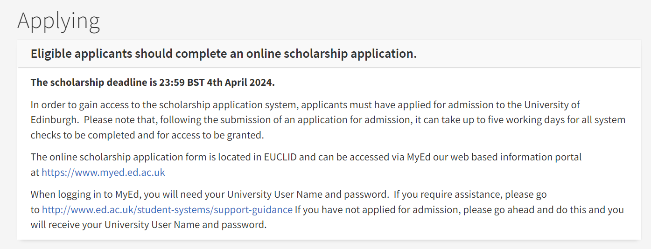
Luksic Scholarship at Edinburgh Futures Institute
How to Apply:
Second Step:
Apply for the scholarship
Closing date: 4 April 2024
Places Awarded: 13 June 2024
Apply Today!
Visit: https://tinyurl.com/LuksicEFI
Further instructions on how to apply found here:
https://www.ed.ac.uk/student-systems/support-guidance/applicants/apply-scholarship/pg-scholarship
#ChallengeCreateChange

Slide 30
Questions?
for further queries contact: efi.education@ed.ac.uk
visit the EFI web site: https://efi.ed.ac.uk/postgraduate-study
Learn more about life on campus for international students here:
https://www.ed.ac.uk/studying/postgraduate/student-life/international

Slide 31
Dr Kate Orton-Johnson
Director of Education, Edinburgh Futures Institute
#ChallengeCreateChange

