Slide 1
Information Session
7 November 2023

Slide 3
The UK’s only specialist social science university

Slide 4
Teaching departments
Accounting
Anthropology
Data Science
Economic History
Economics
Finance
Geography and Environment
Government
International History
International Relations
Language Centre
Law School
Management
Mathematics
Philosophy, Logic and Scientific Method
Psychological and Behavioural Science
Social Policy
Sociology
Statistics
European Institute
Gender Studies
Health Policy
International Development
Media and Communications
Methodology
School of Public Policy
[Graduate students only]

Slide 5
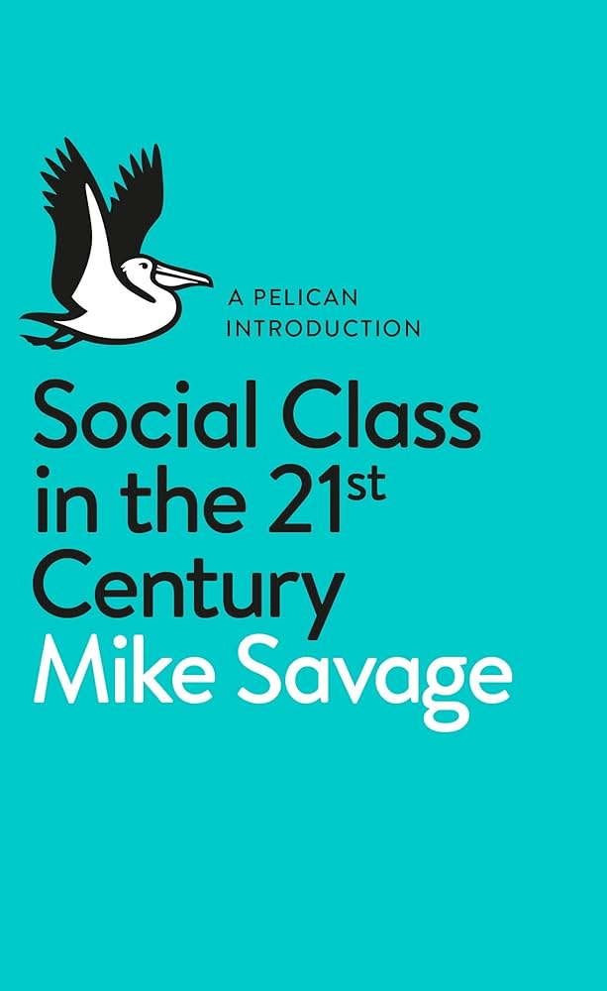
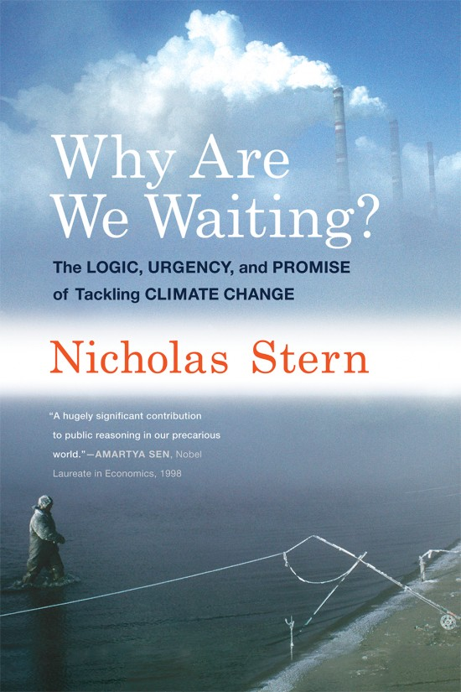

Slide 6
The UK’s only specialist social science university
A university with global impact
12,000 students
5,500 undergraduate
6,000 graduate

Slide 8
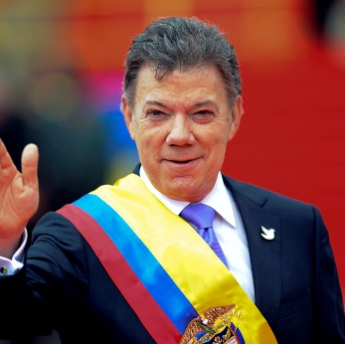
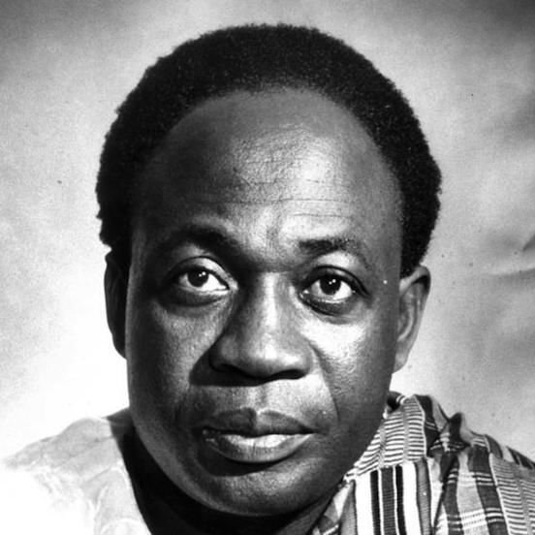
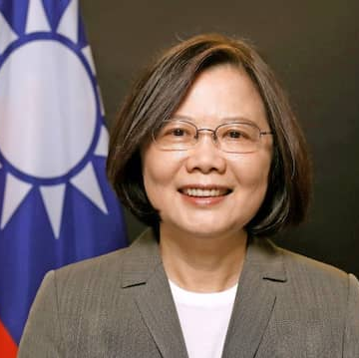
One of the most diverse student communities in the world
80% of our graduate students are from outside UK
… from over 140 countries
… speaking more than 100 different languages
37 world leaders have studied or taught at LSE, including…

Slide 9
Chile
Students
Currently more than 80 Chilean students at LSE
LSE Students’ Union Chile Society
Engagement
World-leading research and expertise
Alumni network
Professionals working across Chile
Events, networking, career development

Slide 10
8 masters programmes designed for early stage to executive level students
Core training in economics, political science and policy evaluation
Focus on application of skills to real-world problems and contexts
Professional development programmes and ‘policy in practice’ sessions for students
Member of the Global Public Policy Network (GPPN)
Notes:
Focus on application of skills to real-world problems and contexts – We have a number of Professors in Practice and expert speakers who share their experiences from working in governments around the world.
Professional development programmes and ‘policy in practice’ sessions for students – ‘policy in practice’ speaker series =regular events where practitioners are invited to speak directly to SPP students about their experiences in public policy. Professional Skills programme = a series of training workshops with experienced practitioners and experts in key areas of professional development such as leadership, negotiation and persuasive communication.
Member of the Global Public Policy Network (GPPN) – 8 world leading policy schools. Annual conference each year in different global locations (2023 Brazil, 2024 France). Students can apply to take part.
https://www.lse.ac.uk/school-of-public-policy/Student-community

Slide 11
LSE SPP Students (2023 year 1 intake)
250 Students
56 Nationalities
Backgrounds including:
- Government administration, Law, Economics, Finance, Consultancy, Engineering, NGOs, Healthcare, Education and more..

Slide 12
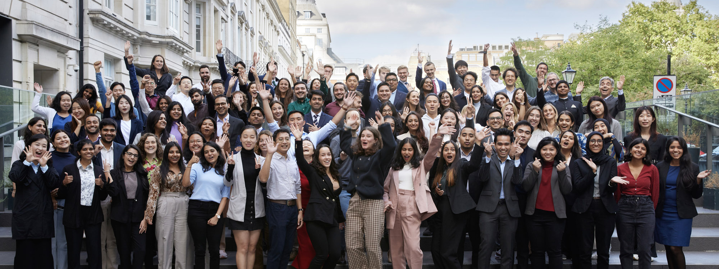
Master of Public Administration (MPA) Programme
2 years, full-time
For early-stage career. No requirement for prior professional experience.
Combines methodological discipline and practical application through Capstone Project with external client
Notes:
Academic core skills - rigorous empirical training, particularly in micro- and macro-economics, political science and quantitative methods of analysis.
MPA Y1- Three compulsory courses + option courses
- Micro and Macro Economics for Public Policy
- Political Science and Public Policy
- Quantitative Approaches and Policy Analysis
MPA Y2 - Capstone Project with an external client, Option to specialize, Option courses incl. option for policy paper (6,000 words) or dissertation (10,000 words)

Slide 13
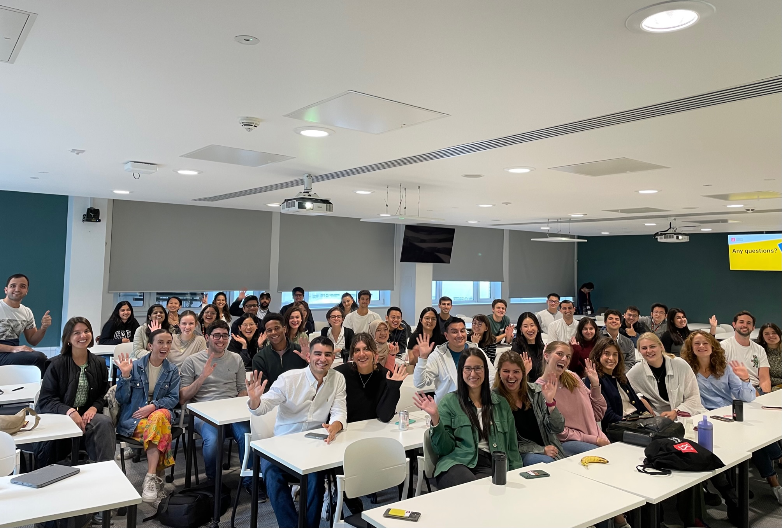
MPA Students (2023/4)
66 class size
26 average age
3 years (avg.) professional work experience
24 nationalities represented
Notes:
Picture of our current MPA Y1s during welcome
Range of professional and academic backgrounds. Optional readings and preparation materials in maths and stats are available for those with less experience in quants, so they can refresh their skills before starting the programme (don’t worry!).

Slide 14
Master of Public Policy (MPP) Programme
Intensive 9-month programme
For early to mid-stage career professionals. 5+ years professional experience required
Develop a deeper understanding of how policy, policy-making, and ‘craft of government’ works
Shape your career trajectory and develop your professional networks
Notes:
- six core courses and option courses.
Political Science for Public Policy* On this course you will learn how to understand and analyse empirically the political context of policymaking. This will include how political behaviour (such as voting behaviour, elections and lobbying), interacts with political institutions (such as electoral systems, different models of government or central banks) to create political outcomes (such as economic policies, development aid and ethnic conflict).
Quantitative Methods for Public Policy* This course will introduce you to some of the key principles and tools of quantitative evaluations which underpin policy interventions and outcomes. The emphasis is on the practical application of these tools to real-life situations, including the difference between correlation and causality, the use of randomised experiments, and understanding of how and when difference-in-differences regressions can be effectively used.
Public Management* This course offers an intensive introduction into key literatures and themes in the study of public management. Applied to both developed and lesser developed world contexts, you will learn about public sector reform, coordination and collaboration, bureaucracies, professionalism and motivation, performance management, crisis management, leadership, institutional capacity building, cutback management and organisational learning. Your teaching will be paired with insights to the success, or otherwise, of different models and approaches.
Economics for Public Policy* On this course, you will learn the key principles of economic policy-making. Both micro- and macro-economics will be covered, including price theory, understanding markets, externalities, public goods, principal-agent problems, economic growth, inflation business cycles, unemployment, and fiscal and monetary policies.
Public Policy Applications* This course will introduce students to the application of social science literatures to concrete policy issues. The course will be organised around topics which are being actively discussed in both the policy and academic spheres/realms/domains. This course will emphasis illustrating how different theoretical and disciplinary approaches analyse a particular policy topic and problem. The precise policy topics will be decided each year, depending on the academic and practitioner availability. We attract from either the cutting edge of a particular research topic or those who are working directly on a topic area.
Philosophy for Public Policy* This course has been designed to help you develop the skills and insight to apply philosophical reasoning to your understanding and practice of the 'craft of government'. It includes a strong grounding in moral and political philosophical principles and emphasises their application in modern policy-making toolkit. You will study a range of philosophical theories and concepts, then discuss and learn to evaluate them by focusing on specific policy proposals. Taught by leading LSE philosophers, the emphasis is on applying theory and concept in practical and policy-relevant ways.
Option courses (electives)

Slide 15
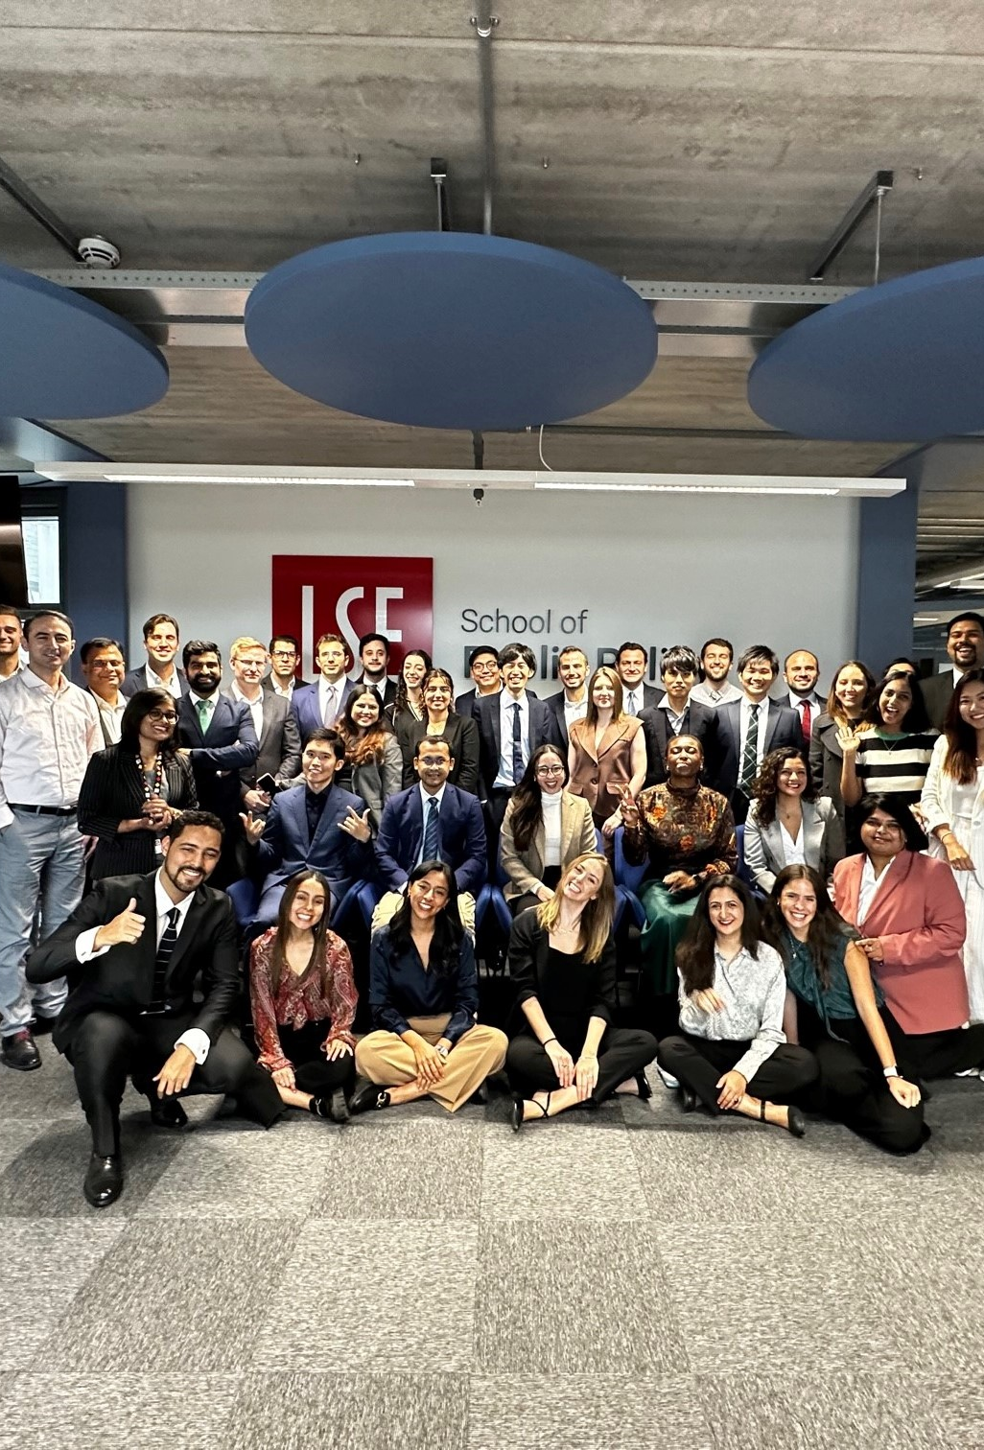
MPP Students (2023/4)
73 Class size
32 average age
9 years (avg.) professional experience
33 nationalities represented
Notes:
Pic of current 2023 intake during welcome

Slide 16
Application
& Admissions Process

Slide 17
Programme Entry Requirements
Academic requirements
A first or upper second-class honours (2:1) degree or a non-UK equivalent
Professional experience
MPP – 5+ years of relevant professional experience
MPA – No formal requirement although students usually have some prior professional experience.
High level of English language proficiency
Notes:
we would normally require a grado de licenciado/licenciatura (achieved after four years study) or the título (profesional) de [subject area] (awarded after the grado de licenciado or the grado de bachiller/bachillerato) with an overall mark of 5/7 (bueno) or 70 per cent.

Slide 18
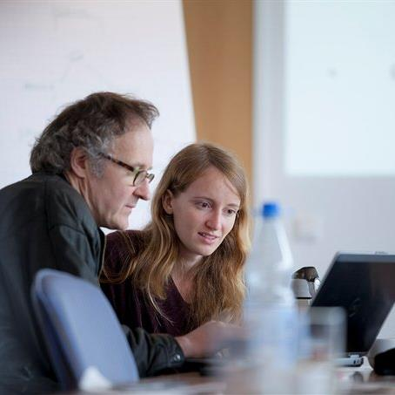
Statement of Academic Purpose
Two sides of A4 paper (1,000 - 1,500 words)
For your chosen programmes, outline your:
Interest
Understanding
Suitability
Purpose and objectives
Focus on the origin of your interest in this subject/area
Your statement should:
describe your academic interests, strengths and background relevant to the programme(s)
outline your academic ambitions and/or research interests, and any professional aspirations.
Notes:
Your statement(s) should be typed and no longer than two sides of A4 paper. There is no fixed word limit, but we expect statement(s) to be no longer than 1,000 - 1,500 words
For each programme you apply for, you must upload a statement that describes your academic interest in, understanding of, and suitability for that programme, as well as your purpose and objectives in undertaking this graduate study.
Any specific requirements for your chosen programme will be listed on the Programme Page. Use the Programme structure and content section to research the modules you will be taking and shape your statement of academic purpose.

Slide 19
How to Apply
Programme application
Online application
Includes supporting documents (CV, statement of academic purpose)
Two references – can be professional
£95 application fee (includes two programme choices)
Application deadlines
MPA or MPP Programme application deadline 12 January 2024
Must be a complete application including references
Scholarship application LSE Graduate Financial Support form (GFS) deadline 19 February 2024
Notes:
Applications for graduate study are an online application. You can make one application per application cycle (usually October to September) and you can make up to two programme choices on each application.
You must upload all of your supporting documents (i.e. CV, statement of academic purpose) and nominate two suitable referees. Your submitted application will not be processed and considered until we have received all the required supporting documents, including references.
Ideally one reference will be academic, however it is up to you to select the best referees. If your chosen programme requires professional experience, one or even both referees could know you in a professional capacity. If you graduated a long time ago or haven’t stayed in touch with your lecturers, professional referees may be more suitable.
The application assessment fee is £80- If you are unable to pay either the reinstatement or application fee you can request a waiver to allow your application to be considered by the department.
There is a rolling admissions for most MSc programmes, however it is advised that apply early, as competition for programmes at LSE is intense. For the MPP/MPA programmes there are set deadlines, and note for double degrees which institution you apply to.
More information on supporting documents can be found on our website.

Slide 20
What are the criteria for the Luksic Scholarship for Public Service ?
To be considered for the Luksic Scholarship you must:
be ordinarily based in Chile
have submitted your application for admission to the MPA or MPP programme in full by the deadline 12 January 2024
AND
submitted the LSE Graduate Financial Support online application by the deadline 19 February 2024.
Your application must demonstrate:
A commitment to public service in your future career with a compelling rationale for choosing this vocation
Your potential to become a future expert and leader in your field, and thereby to generate positive change for Chile
Previous academic excellence, evidenced by grades from previous university study and supported by references from previous professors

Slide 21
What else do I need to know about applying for the Luksic Scholarship for Public Service ?
Preference may be given to those applicants who can demonstrate a professional background or other experiences that strongly suggest potential for innovation and original thinking coupled with demonstrated success.
Preference will be given to those applicants who would otherwise lack the financial means to study at the LSE School of Public Policy.
Note: The awarding process will seek to balance applicants from different regional areas of Chile.
Find out more information at www.lse.ac.uk/spp/study/SPP-financial-aid

Slide 22
Next Steps…
Find out more about our programmes and students on our website lse.ac.uk/spp/study
Find answers to your questions and contact us through the Knowledge Base
Register for a MPA or MPP programme information session with our faculty
SPP programmes info session – 13 November 12.30pm (UK)
MPA info session – 17 November 1pm (UK)
MPP info session – 4 December 1pm (UK)
Apply!
Notes:
SPP recruitment events link: https://www.lse.ac.uk/school-of-public-policy/study/Recruitmentevents

