Slide 1
N O V E M B E R 2 0 2 3
M A S T E R O F P U B L I C P O L I C Y A N D T H E L U K S I C S C H O L A R S H I P
B l a v a t n i k S c h o o l o f G o v e r n m e n t
A w o r l d b e t t e r l e d , b e t t e r s e r v e d a n d b e t t e r g o v e r n e d .

Slide 2
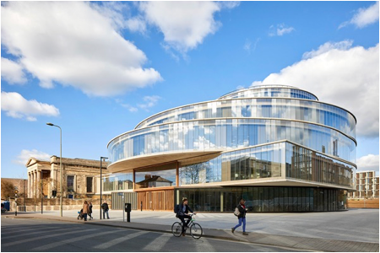
A B O U T T H E
B L A V A T N I K S C H O O L
The School’s mission is to inspire and support better government and public policy around the world

Slide 3
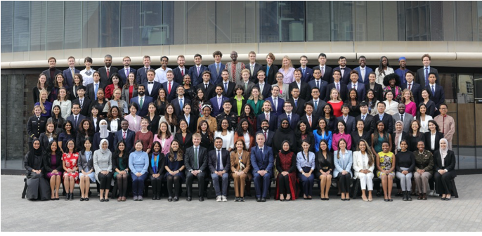
T E A C H I N G
Graduate degree programmes
MPP in Public Policy
MSc in Public Policy Research
DPhil in Public Policy
Executive education programmes Online courses

Slide 4
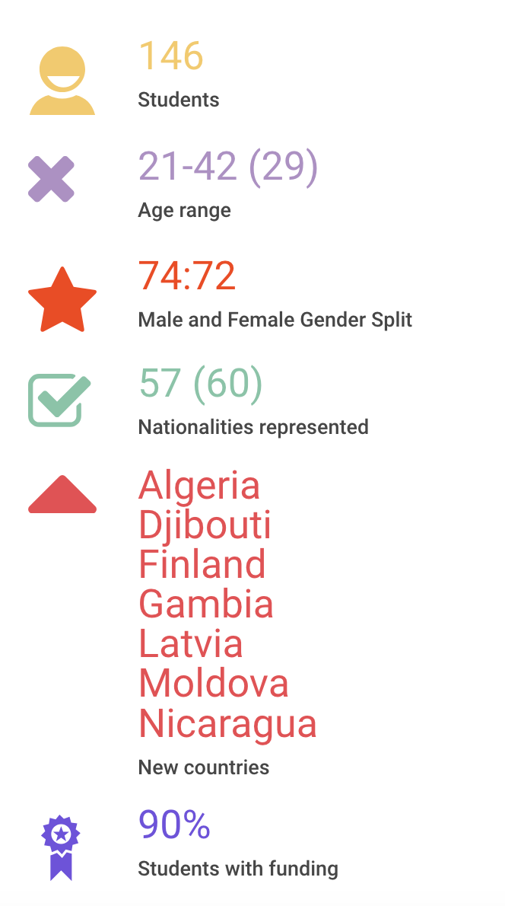
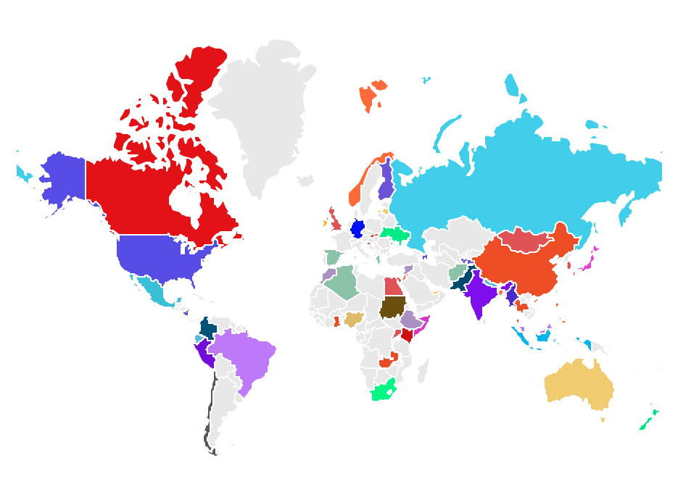
M P P 2023/24
C O H O R T 1 F A C T S A N D F I G U R E S

Slide 5
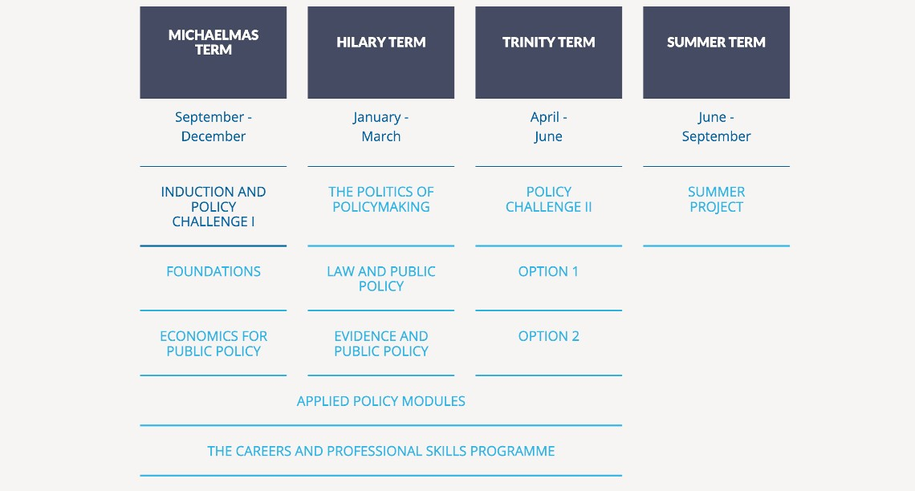
M P P S T R U C T U R E A N D C O U R S E
C O N T E N T

Slide 6
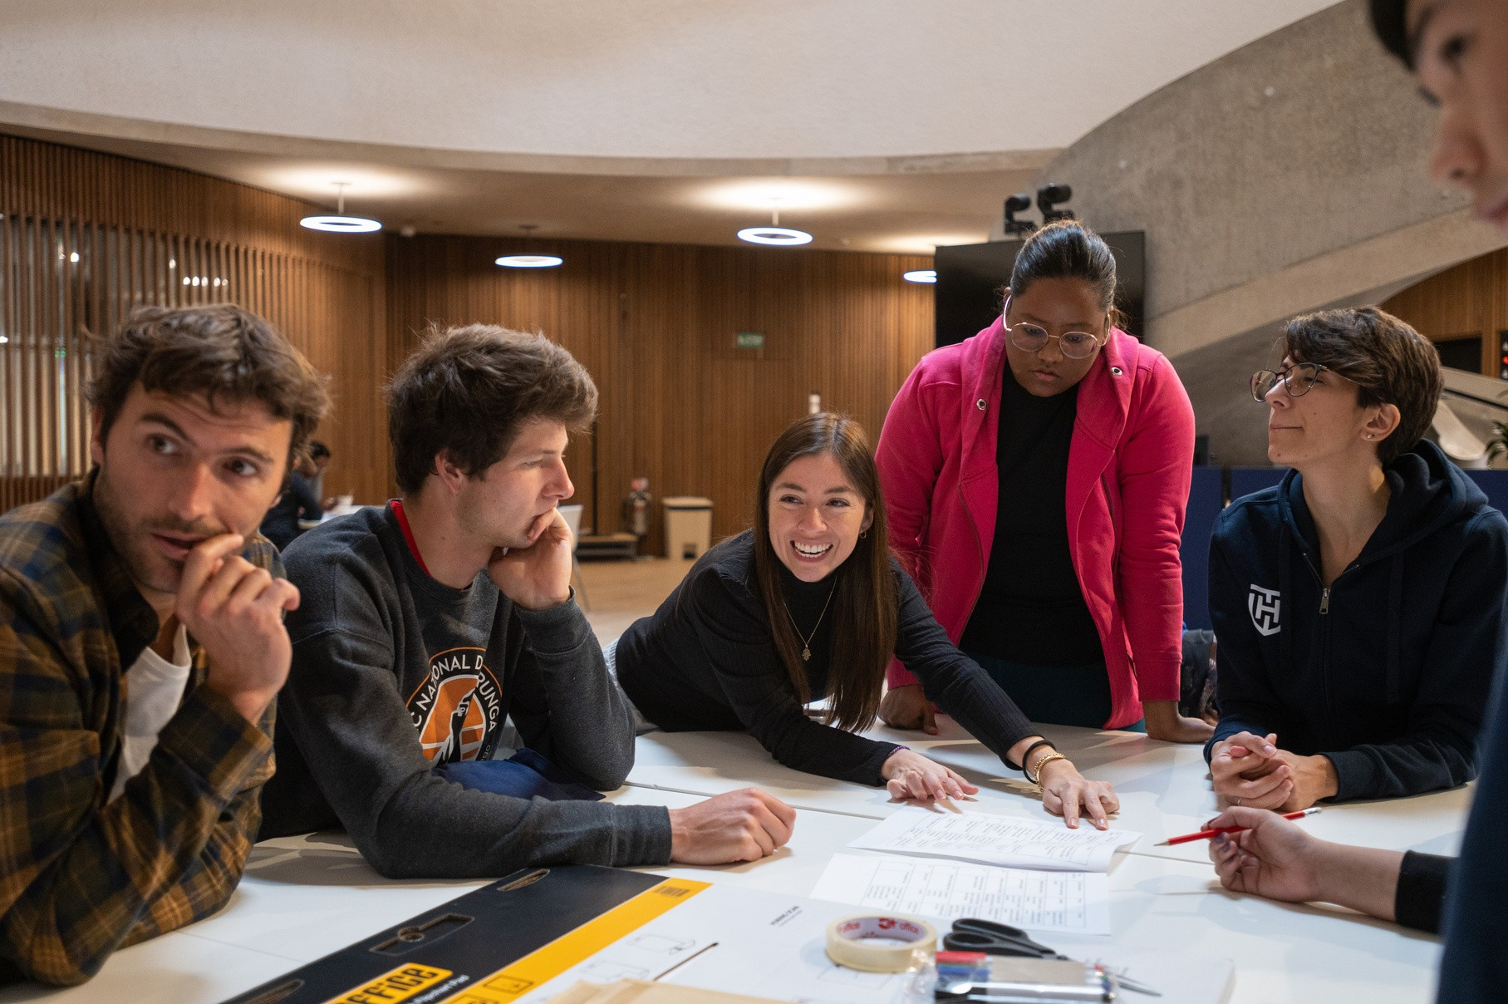
L U K S I C S C H O L A R S H I P
Up to three scholarships each year
Eligibility:
Chilean nationals (ordinarily resident in Chile)
Includes:
Full tuition
Living allowance to cover expenses for the 12-month programme duration
Process:
After offers are made, a Scholarship Questionnaire will be sent

Slide 7
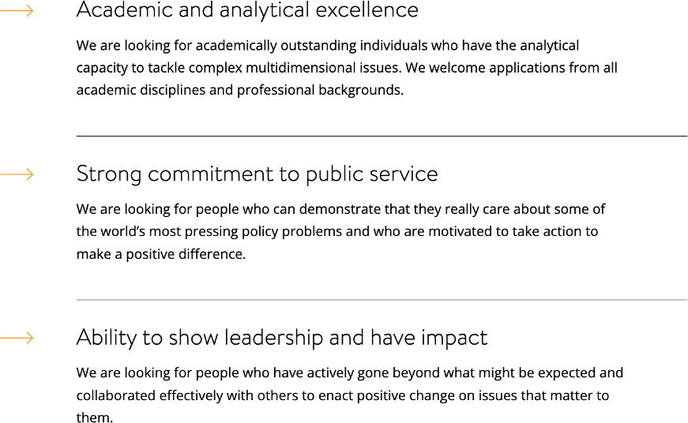
S E L E C T I O N C R I T E R I A

Slide 8
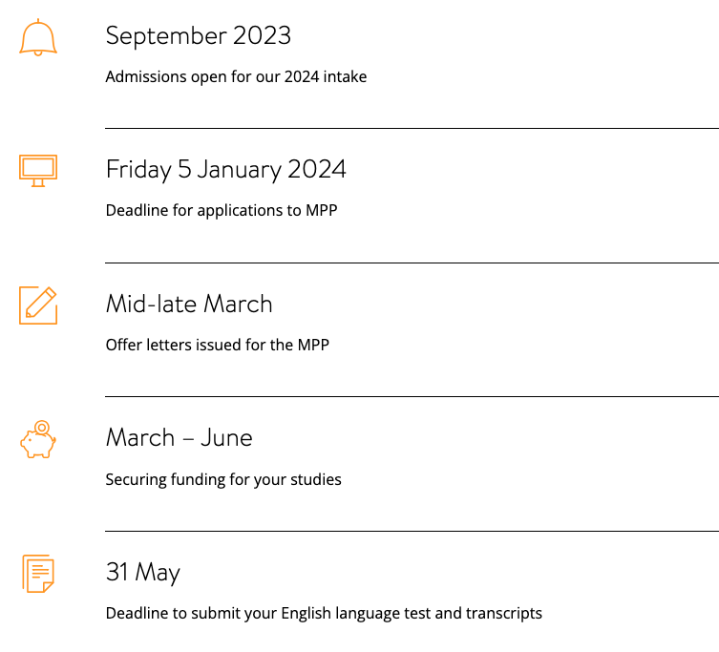
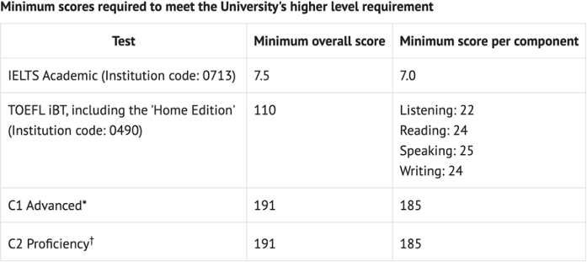
A P P L I C A T I O N P R O C E S S

Slide 9
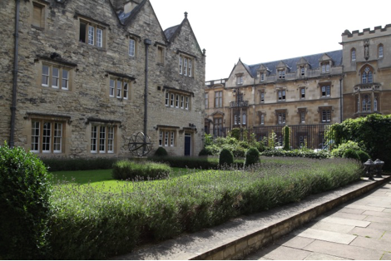
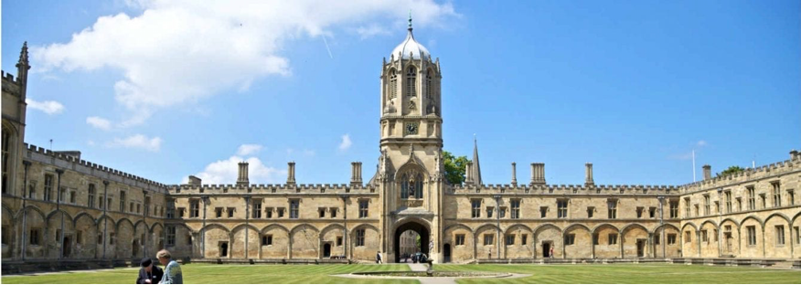
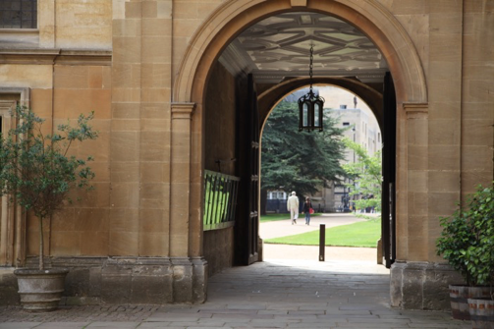
O X F O R D U N I V E R S I T Y A N D C O L L E G E S

Slide 10
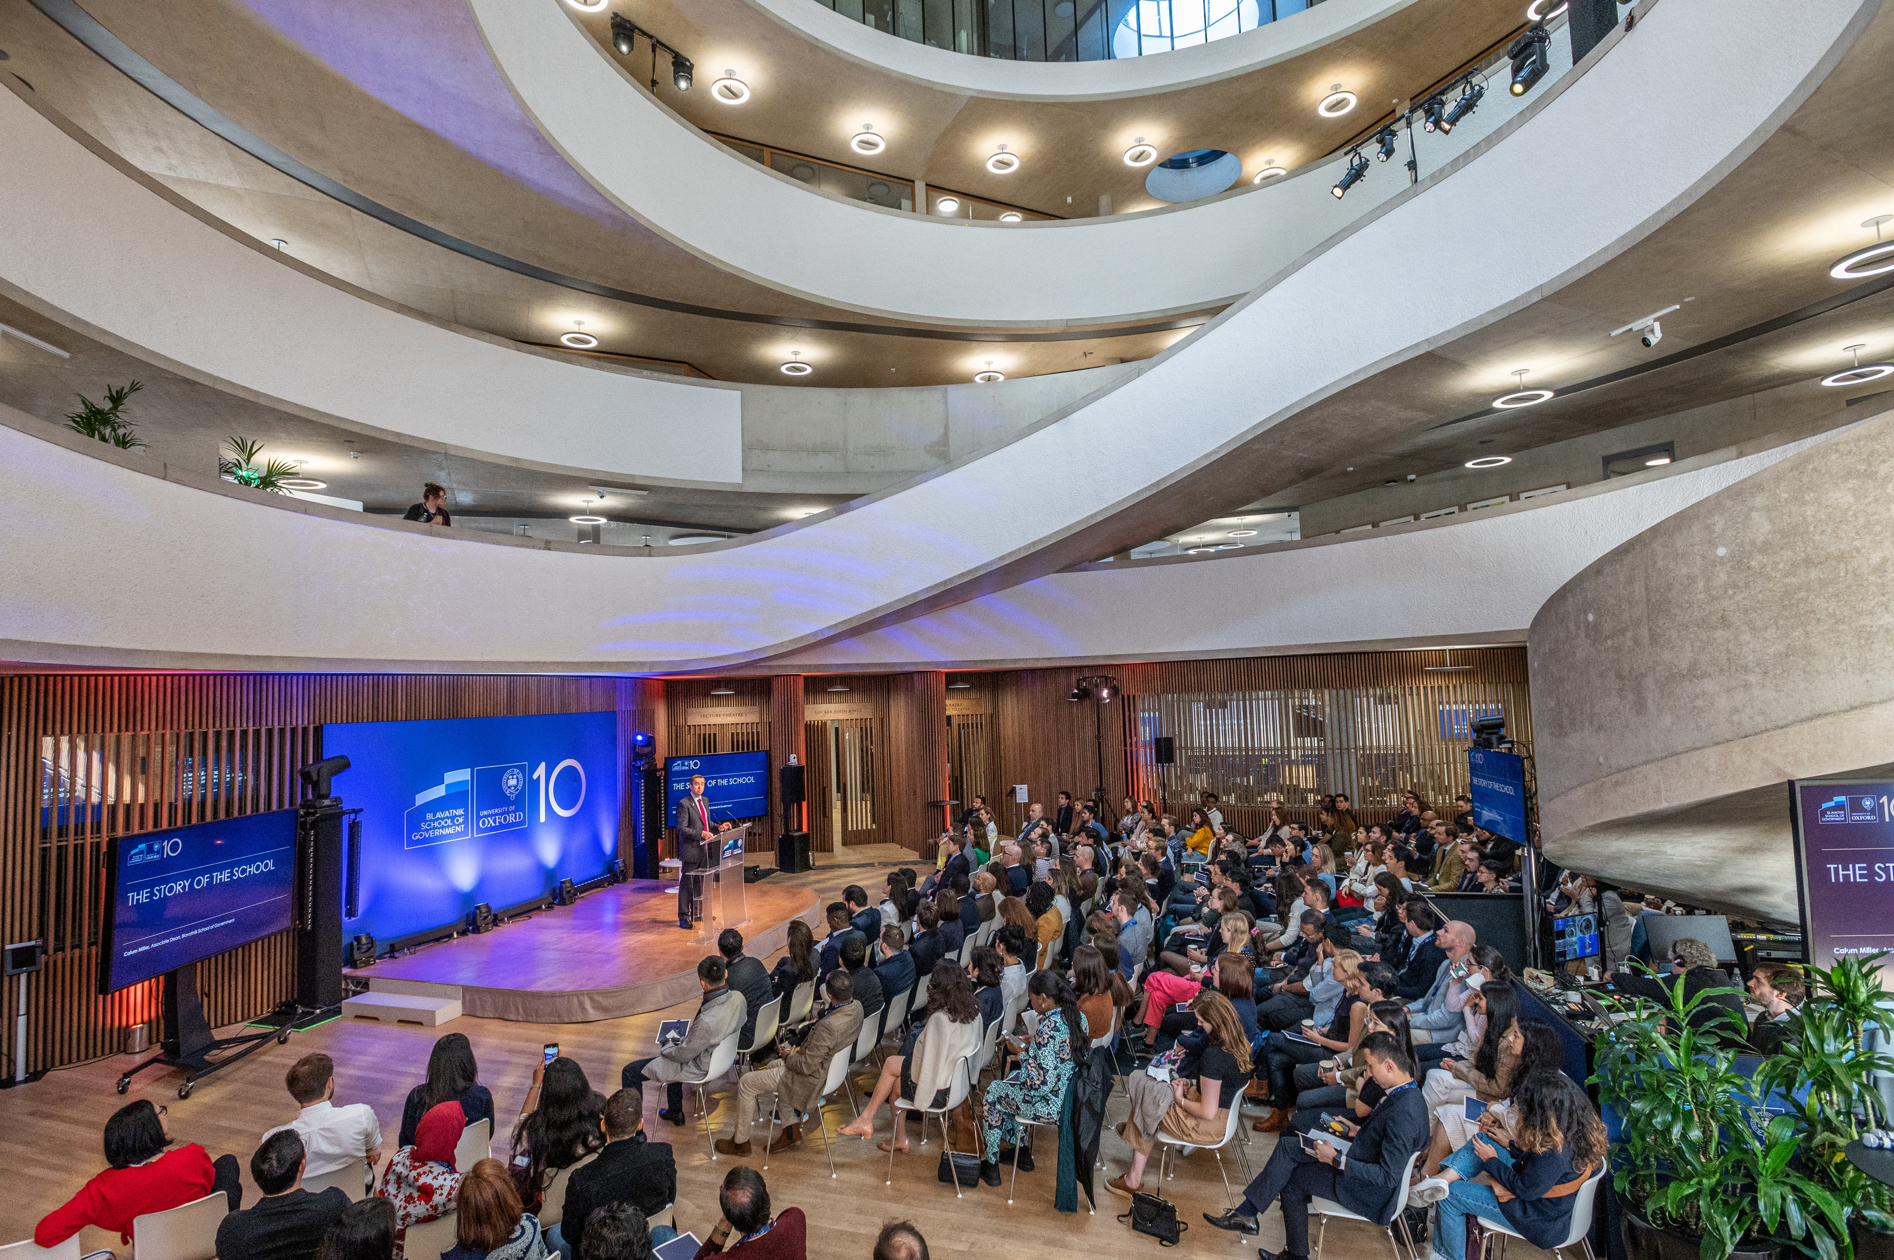
F I N D O U T M O R E
Visit our website: www.bsg.ox.ac.uk
Find us on social media:
@ b l a v a t n i k s c h o o l
@ b l a v a t n i k s c h o o l O x f o r d b s g
B l a v a t n i k S c h o o l o f G o v e r n m e n t

Slide 11
T H A N K Y O U F O R L I S T E N I N G

